Slide 1
Testing in .NET:
What you need to know about Integrating Testing & Development
Mary Romero Sweeney
Sammamish Software Services
www.sammamishsoftware.com
Copyright Sammamish Software Services 2006; All rights Reserved
Notes:
Testing in the .NET environment has changed radically within only the past few years from a black box approach to today's full integration of software development and test in the .NET platform itself. Find out what this new approach means to you and to the future of the software testing industry.
This talk is not just for Microsoft shops! This new approach may just revolutionize the how testing and development are treated in the software process now and into the future. Will your approach be left in the dust?
Mary Romero Sweeney is the author of “A Tester's Guide to .NET Programming”, and is not a Microsoft employee. She will guide you through the pros and cons of working in this environment and discuss what testing in .NET environment today means to you, your company, and today's testing industry.
What you will learn:
Learn how the new approach affects your best practices for development and test
How testing in .NET compares to traditional and current practices
Beyond the hype: Find out what the problems and advantages are with this approach and what it can and can't do for you.
Learn about the new features in the Team Edition for Testers software that are creating all the buzz

Slide 2

Quick Bio
Former developer both embedded and business systems for the Boeing Company
Published “Visual Basic for Testers” Apress Aug, 2001
Published “A Tester’s Guide to .NET Programming” Apress, Feb 2006
See Chapter 11 !

Slide 3
Today’s talk
This talk is not intended only for Microsoft customers; we want to talk about a new approach to test development
In this talk I will provide only an overview of the features available in Visual Studio’s Team Test software in order to give you a feel for its power and capabilities for comparison to your own efforts
  We will not be covering the entire feature set of this new addition; this is not a Microsoft-sponsored presentation!

Slide 4
Test Techniques Timeline
Automated Testing using
3rd party tools
Test and Development Integration
Into Development platform software
Automated Testing
Using Open Source Tools
Manual Testing
Note: All along many have had support from white box testers with coding skills enabling companies to create their own unique automated tests

Slide 5


Traditional Automation Software vs Integrated Dev and Automated Test
Status Quo
Automation
Software
Integrated
Development and
Automated Test
Application
Software

Slide 6
Problems with the status quo
Tool bundling
  This occurs because vendor tools often don’t have all the capability needed
  Decreases communication due to the lack of integration
  Adding diverse tools from different makers makes communication transfer difficult. Many vendors add to this issue by acquiring “new features” that are just acquisition of other companies tools
  Expensive vendor tools vs. risky open source tools is a tough choice
Do it yourself test harnesses
  Lack of commonality and lack of enough available talent

Slide 7
Microsoft’s Team Edition for Testers
With the release of Visual Studio 2005, Microsoft has integrated a significant amount of test capability into Visual Studio with its Visual Studio Team Test software
The idea behind the Team Test software is the integration of testing tools into the software development environment.
  Developers create code and then create Unit Tests and Test Engineers use these unit test shells to create more sophisticated system tests
  OR, Tester’s can create the Unit Tests from development code
For example

Slide 8
Cross Organization communication
Intent is to create a setting where information can be shared across all the groups involved in software development.
Tests and their results can then be shared and managed across the organization—from management to the development and test teams, and back again.
  Test Results can be published by the software into reports and graphs
Dev
Test
Test
development/
publication
Mgt

Slide 9
Team Edition for Testers
There are a variety of test types to address different organizational processes and software development methodologies, including Agile, Extreme, and Test First testing methods, as well as the traditional software lifecycle model.
  Types of Tests:
    Web,
    Load,
    Ordered,
    Manual,
    Unit,
    Generic
Notes:
Web: With a web test, you can verify the functionality of your web applications. You can navigate through the site, clicking on different buttons, links, forms, etc. and all the web traffic gets saved and can then be played back and verified without your writing code to do so.
Load: Load tests allow you to take other tests (except manual tests) and run them simultaneously under simulated load using virtual users. This type of test allows you to set thresholds and to see where performance points you have identified have failed. You can collect and evaluate the resulting performance data.
Ordered: You can place a set of existing tests in an ordered container so that they will run in an order you specify. This is important where certain kinds of tests are dependent on others. Ordered tests support end-to-end testing.
Manual: This test type allows you to create tests that are a description of the steps that you want a tester to manually follow. You can use Microsoft Word or a text file to create these. This feature simply allows you to keep track of your manual tests along with the other tests in your project. A manual test cannot be aggregated into a load test.
Unit: Sometimes called White Box testing, this is typically a development task or a task for the technical tester, especially those involved in Agile or Extreme testing environments. A unit test can be set up to exercise Visual Basic, C#, or C++ source code. You can also create data-driven unit tests that use a database to read and store data. Unit tests can also be created for ASP.NET applications.
Generic: The generic test type allows you to take an existing program you have and wrap it to function as a test that can be executed inside Visual Studio. You can harness existing nUnit tests this way.

Slide 10
Test Types
Web:
  Verify the functionality of web applications. Navigate through the site, clicking on different buttons, links, etc. and all web traffic gets saved and can be played back
Load:
  Take other tests (except manual tests) and run them simultaneously under simulated load using virtual users. Allows you to set thresholds and to see where performance points have failed. Resulting performance data can be collected and reported.
Ordered:
  Place a set of existing tests in an ordered container.
  Continued…

Slide 11
Test Types, continued
Manual:
  Describe the steps for a tester to follow manually. Provides a way to keep track of your manual tests along with the other tests in your project.
Unit:
  Create code-generated tests for your components. You can also create data-driven unit tests that use a database to read and store data.
Generic:
  The generic test type allows you to take an existing program you have and wrap it to function as a test that can be executed inside Visual Studio. Harness existing nUnit tests this way.

Slide 12
Test Team support for Component Testing
But, Unit (component) testing is traditionally considered the domain of the development team!?
  Not so in Agile and Test First methodologies
  No one is suggesting that developers stop doing unit testing; however, a test professional can add great value to the project by incorporating professional test expertise into the unit testing process.

Slide 13
The Process
For Unit Testing
Developer creates component
Depending on methodology employed the skeleton test harness for the component is created by either the developer or a tester
Test professional enhances the harness with proper test expertise
  Including equivalence classing, boundary analysis, etc.
Test Team executes and provides results to management and developer.
Developer uses integrated environment to directly and quickly address test issues
Warning! Code on next page…..

Slide 14
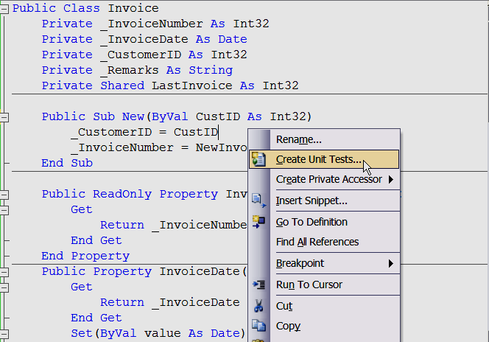
Creating a Unit Test in an Integrated Environment
Human error sometimes accounts for missed methods and classes
Code generation can develop the skeleton of your unit tests
  Namespaces
  Classes
  Methods

Slide 15
Generated Test Code
<summary>
'''A test for NewInvoiceNumber()
'''</summary>
<TestMethod()> _
Public Sub NewInvoiceNumberTestMethod()
Dim CustID As Integer = 0
Dim target As Invoice = New Invoice(CustID)
Dim expected As Integer = 75
Dim actual As Integer
actual = target.NewInvoiceNumber
Assert.AreEqual(expected, actual, _
"InvoiceLib.Invoice.NewInvoiceNumber did not return the expected value.")
End Sub

Slide 16
What’s the effect on best practices for development and test?
The developer often does not have the time and certainly does not always have the correct mindset to perform thorough Quality Assurance testing
  In fact, in many organizations what’s being done is more along the lines of Unit Exercising or simply ensuring basic functionality not full professional testing
Integration of test with development allows for more detail support from the test team and cross-department communication of metrics
Eases the introduction of test support earlier in the software development process

Slide 17


Problems and advantages
Downside:
  Only the VS 2005 Team Test Edition of Visual Studio gives you the full capability including reporting
  Expensive! Due to the cost, many .NET customer companies will stick with nUnit and other automated testing tool options

Slide 18

Problems and advantages
Upside:
  Gets test and development not just thinking about but doing testing MUCH earlier in the software process
  Increases the role and capability of the Test Engineer
  Provides far more visibility to management on test development and progress
  Provides for more quick and direct reporting and resolution for certain kinds of bugs

Slide 19
How new integrated testing compares to traditional and current practices
Traditional: black box & manual testing
  If your organization separates test and development and provides little or no white box test support this will involve a major culture change
Test First and Agile methods
  If you are a Windows/Microsoft project then this provides more specific and convenient support
  If you are not Windows/Microsoft, look for more support along these lines from your own platform vendors

Slide 20
DEMOs

Slide 21
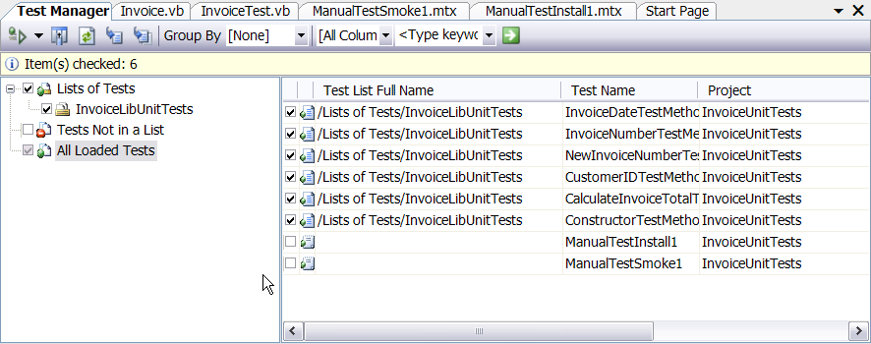
Test Manager window
The Test Manager window allows you to organize and manage your tests and test runs (suites)

Slide 22
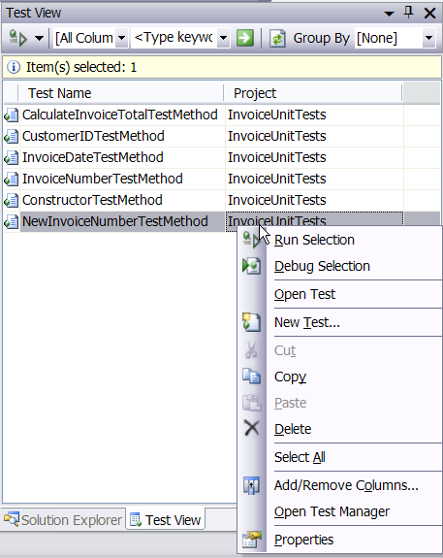
Test View window
Create, run, and organize tests from Test View

Slide 23
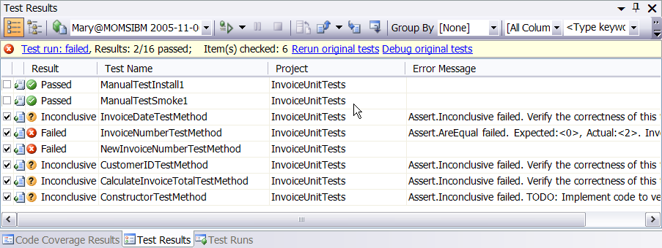
Test Results Window
Test results window provides integrated resolution of test and the opportunity to view more info, debug and rerun

Slide 24
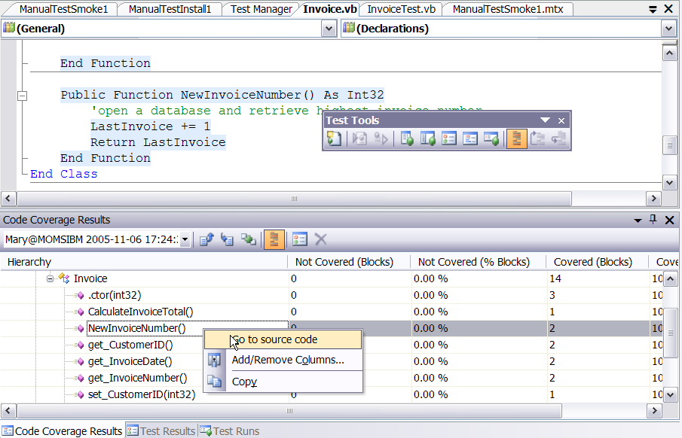
Code Coverage Support
Do you pay for a code coverage tool? It’s built-in here:

Slide 25
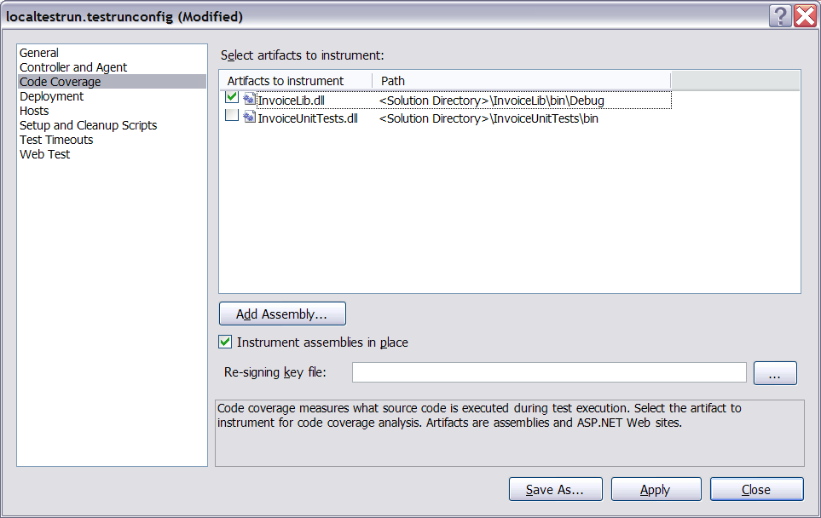
Test Run Configuration window
Tests and test runs are configurable

Slide 26
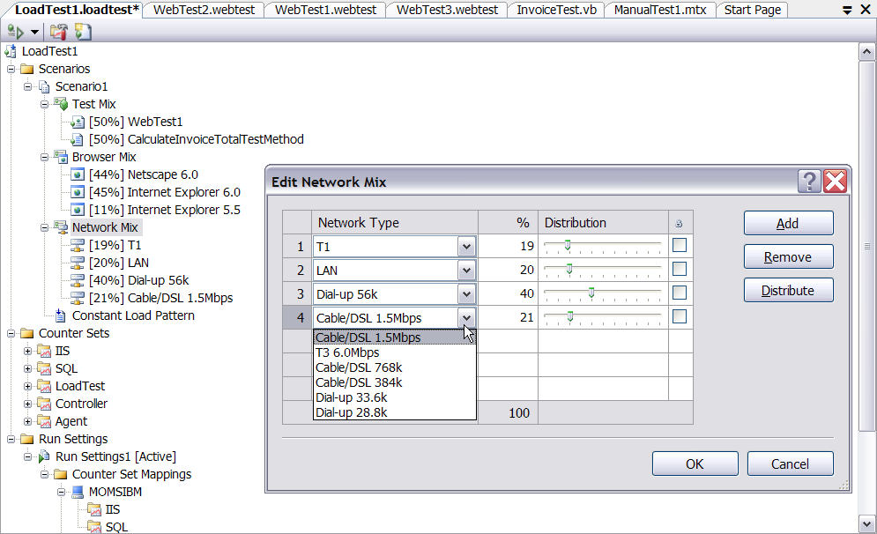
Load Test Settings

Slide 27
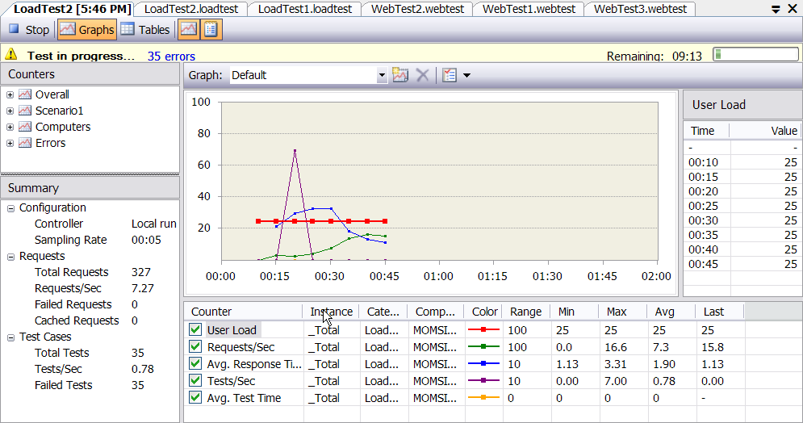
Load Testing Results

Slide 28
Summary/Conclusions
Now using .NET we can test using the development software; this produces many advantages in cross-department communication development
Larger software development companies can make effective use of these integrated tools to save a lot of coding time for automated tests in Visual Studio.
The expense of this Visual Studio version may not be necessary for smaller organizations and is prohibitive for individual testers who want to write quick and simple tests.

Slide 29
Finally a word to the Microsoft users:
If you haven’t upgraded to VS Team System, should you?
  If you do white box testing and coding currently then this could save you hundreds of hours in test development
  Product is very stable for a new release
  If you don’t do white box testing and coding you need to analyze your current talent and determine if this is a good fit; it may be cost prohibitive for anything but the larger shops -- at this time
  Can you do without it? Sure.

Slide 30
The future
Prediction: Integrated test and development platforms will be a standard in the future
  Remember when integrating a debugger into the development platform was a new thing? (OK I’m old)
  We’ll be saying the same thing about having code coverage and test benches in the platform as well.
  Isn’t the cost prohibitive? Not really compared to purchasing multiple tools; the advantage over open source is the same vendor/seamless integration.
    Like most things cost will go down (?)
  How does this affect major test tool vendors? Not good news for them. ☹
Are you ready for this next phase?????

Slide 31
Resources
“Tester’s Guide to .NET Programming”
  by Randal Root and Mary Romero Sweeney (Apress, Feb 2006)
“Pro Visual Studio Team System”
  by Jeff Levinson (Apress, May 2006)
Microsoft (of course)
  http://msdn.microsoft.com/vstudio/teamsystem
  Lots of User’s groups and white papers
Product comparison website:
  http://msdn.microsoft.com/vstudio/products/compare/default.aspx

